Slide 1
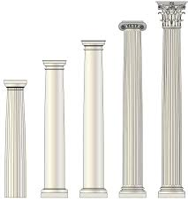
Pillars for Faith
Write a word, phrase, or create a symbol to indicate various “pillars” your parent(s) gave you
upon which you could
place your faith.

