Slide 1
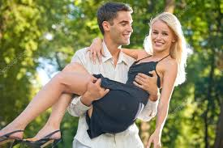
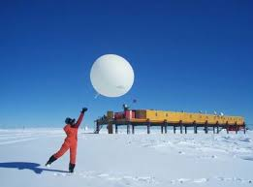
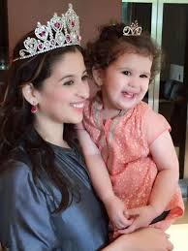
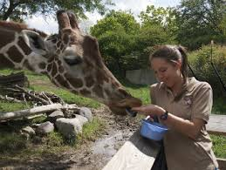
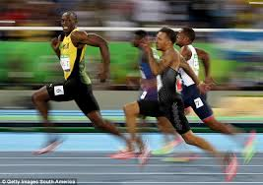
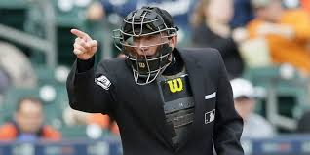
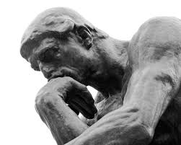
Qualities and Settings
The left column has 5 qualities; the right column has 5 settings.
Cut each of them and draw one from the left options then one from the right options. See how well they match.
Quality:
Physically Attractive
Setting:
Antarctica Weather Post
Quality:
Sparkling Personality
Setting:
Zoo Keeper
Quality:
Very Athletic
Setting:
Baseball Umpire
Quality:
Deep Thinker
Setting:
Uber Driver
Quality:
Super Video Gamer
Setting:
Poet

Slide 2
Qualities and Settings
The left column has 5 qualities; the right column has 5 settings.
Cut each of them and draw one from the left options then one from the right options. See how well they match.
Quality:
Physically Attractive
Setting:
Antarctica Weather Station
Quality:
Sparkling Personality
Setting:
Zoo Keeper
Quality:
Very Athletic
Setting:
Baseball Umpire
Quality:
Deep Thinker
Setting:
Uber Driver
Quality:
Super Video Gamer
Setting:
Poet

